Slide 1
Parameter estimation and model selection
Molly Gallagher, PhD
Georgia Tech Bioinformatics User Group
4 April 2019

Slide 2
Parameter estimation and model selection
Parameter estimation
Nelder-Mead Method
MCMC
Line search MCMC
Convergence testing
Model selection criteria
AIC & AICc
BIC & DIC
WAIC

Slide 3
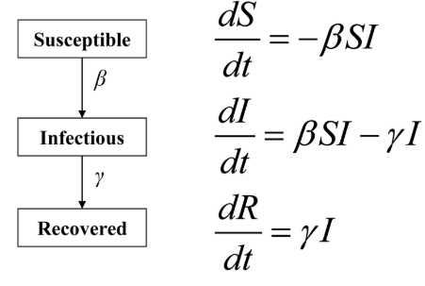
Estimating a single parameter
v
v

Slide 4
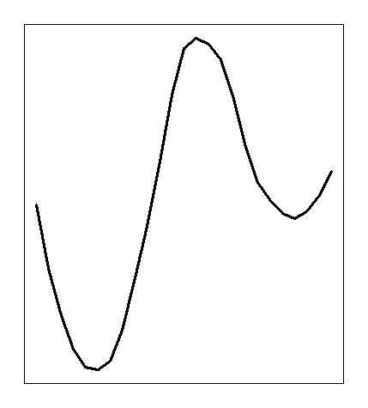
Estimating a single parameter
local
minimum
v
Negative log likelihood (small is better!)
global
minimum
v
Increasing parameter value
Notes:
Mention line search here
This is minimizing a negative log likelihood
Note: minimizing squared error is equivalent to maximizing the likelihood for a linear model with normally distributed error
logarithm is a monotonic function, so optimizing a function is the same as optimizing the log of it
multiplication becomes sums after taking the log
Also, the magnitude of the likelihoods can be very small -- a log transform converts these small numbers to larger negative values which a finite precision machine can handle better.
Likelihood of a model given the data is equal to the probability of the data given the model

Slide 5
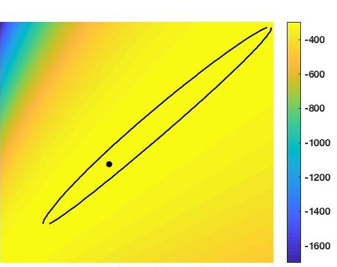
Estimating multiple parameters
likelihood
Loglikelihood
parameter 2
increasing value
increasing value
parameter 1
Notes:
Line search or grid search can work if parameter space is small enough

Slide 6

Nelder-Mead Method
Also known as the downhill simplex, amoeba, or polytope method
Notes:
Generate a simplex in parameter space
Calculate the likelihood at each of these points in space, and also at the centroid

Slide 7
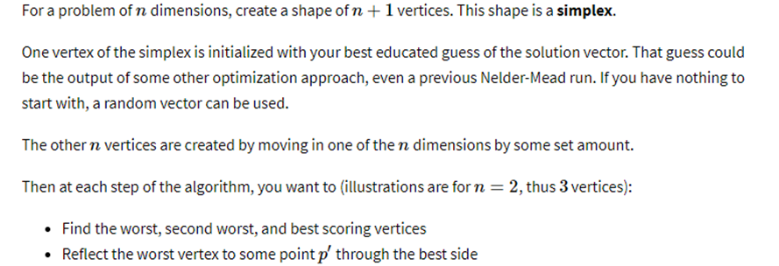
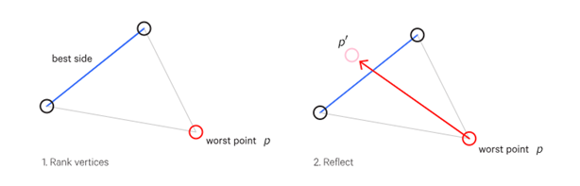
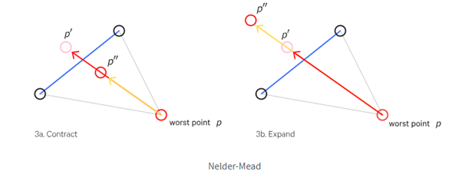
https://frnsys.com/ai_notes/foundations/optimization.html
Notes:
The new point p’ is generated by calculating the centroid and then reflecting it across the ‘best side’ line

Slide 8
https://frnsys.com/ai_notes/foundations/optimization.html
Notes:
The new point p’ is generated by calculating the centroid and then reflecting it across the ‘best side’ line

Slide 9
https://frnsys.com/ai_notes/foundations/optimization.html
Notes:
The new point p’ is generated by calculating the centroid and then reflecting it across the ‘best side’ line

Slide 10
https://frnsys.com/ai_notes/foundations/optimization.html
Notes:
The new point p’ is generated by calculating the centroid and then reflecting it across the ‘best side’ line

Slide 11
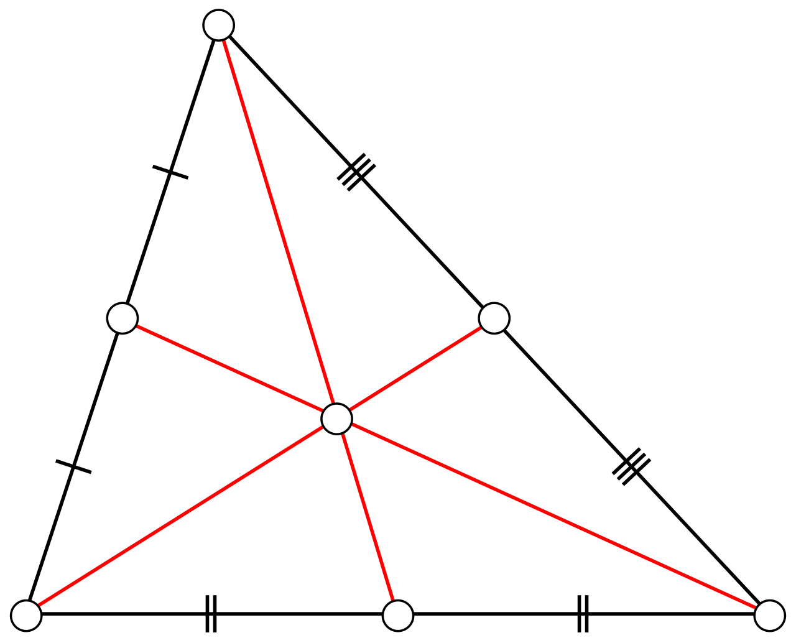

Nelder-Mead Method
Notes:
Generate a simplex in parameter space
Calculate the likelihood at each of these points in space, and also at the centroid
Centroid: the average of the points (here, two parameters, so 3 points)
Also the point at which the object can balance

Slide 12
https://frnsys.com/ai_notes/foundations/optimization.html
Notes:
The new point p’ is generated by calculating the centroid and then reflecting it across the ‘best side’ line

Slide 13
https://frnsys.com/ai_notes/foundations/optimization.html
Notes:
The new point p’ is generated by calculating the centroid and then reflecting it across the ‘best side’ line

Slide 14
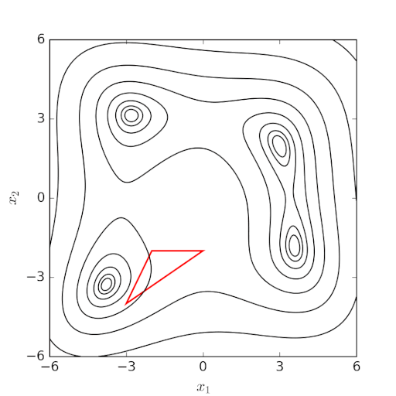
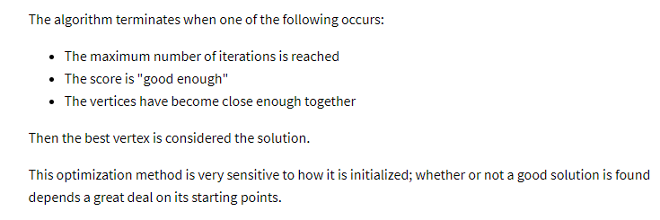
Nelder-Mead Method
By Nicoguaro - Own work, CC BY 4.0, https://commons.wikimedia.org/w/index.php?curid=51597577

Slide 15
With an increase in the number of parameters, this method can break down
likelihood
Loglikelihood
parameter 2
increasing value
increasing value
parameter 1

Slide 16
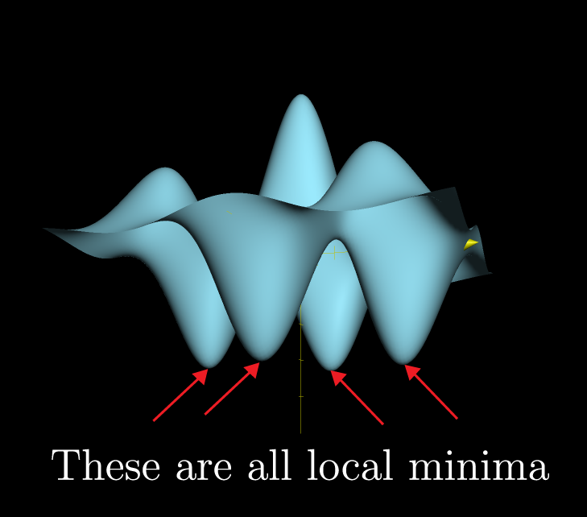
With an increase in the number of parameters, this method can break down
likelihood
Loglikelihood
parameter 2
increasing value
increasing value
parameter 1
Notes:
https://www.khanacademy.org/math/multivariable-calculus/applications-of-multivariable-derivatives/optimizing-multivariable-functions/a/maximums-minimums-and-saddle-points

Slide 17
MCMC: Markov chain Monte Carlo
Negative log likelihood (small is better!)
global
minimum
local
minimum
Increasing parameter value
Notes:
Can be informed by a prior or not
Bounds on parameters
Start chains in different places

Slide 18
MCMC: Markov chain Monte Carlo
If the newly proposed parameter set has a better likelihood than the previous one, it will always be accepted by the algorithm
Negative log likelihood (small is better!)
global
minimum
local
minimum
Increasing parameter value
Notes:
Can be informed by a prior or not
Bounds on parameters
Start chains in different places

Slide 19
MCMC: Markov chain Monte Carlo
If the newly proposed parameter set has a better likelihood than the previous one, it will always be accepted by the algorithm
Negative log likelihood (small is better!)
global
minimum
local
minimum
Increasing parameter value
Notes:
Given these starting conditions, the Nelder-Mead algorithm would get stuck at this point
Acceptance ratio can be greater than one; this means that you accept with probability = 1

Slide 20
MCMC: Markov chain Monte Carlo
If the newly proposed parameter set has a better likelihood than the previous one, it will always be accepted by the algorithm
Negative log likelihood (small is better!)
global
minimum
local
minimum
But the algorithm will sometimes accept a worse parameter set, especially if the likelihoods are not too different
Increasing parameter value
Notes:
You can run the chains in parallel and output the results to a file, which is available for you to do convergence tests at any time
Nice way to avoid having to re-start your MCMC routine because the chains have not converged

Slide 21
MCMC: Testing convergence
Run multiple MCMC chains to ensure they are converging on the same posterior distribution
local
minimum
Negative log likelihood (small is better!)
global
minimum
Increasing parameter value

Slide 22
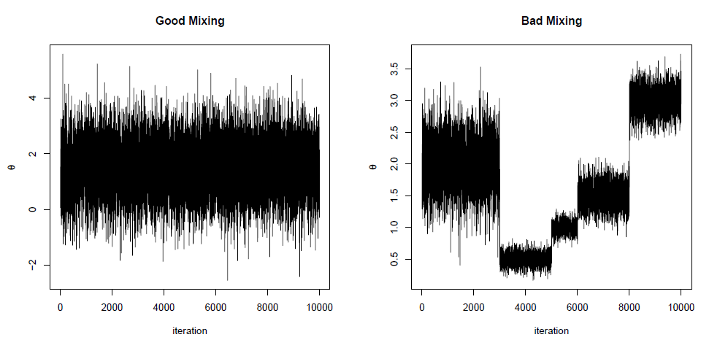
MCMC: Testing convergence
Run multiple MCMC chains in parallel, beginning with overdispersed starting values
Discard the first 50% of your iterations
Visual inspection
Calculate the within- and between- chain variance
Calculate the estimated variance of each parameter
(as a weighted sum of within- and between- chain variance)
6) Calculate the potential scale reduction factor
- this value should be less than ~1.1
Figures by Patrick Lam
https://blog.stata.com/2016/05/26/gelman-rubin-convergence-diagnostic-using-multiple-chains/

Slide 23
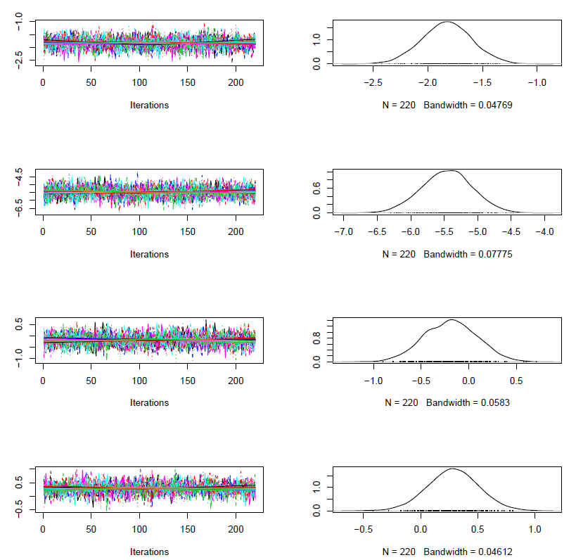
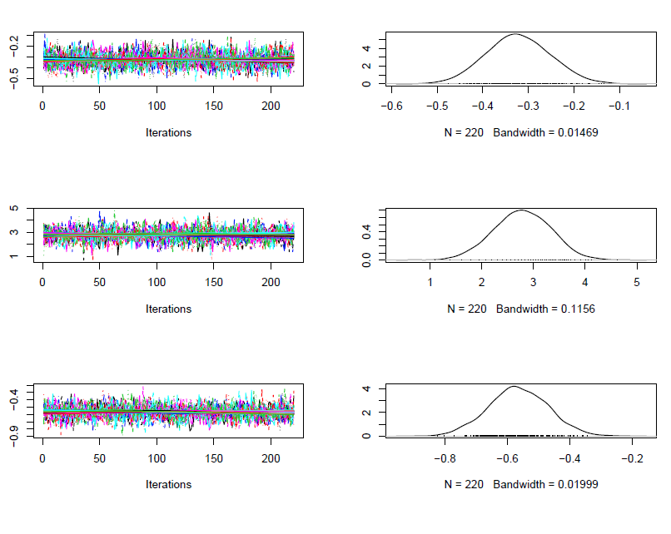
MCMC: Testing convergence
Potential scale reduction factors:
Point est. Upper C.I.
[1,] 1.00 1.01
[2,] 1.01 1.01
[3,] 1.00 1.01
[4,] 1.00 1.01
[5,] 1.00 1.01
[6,] 1.00 1.01
[7,] 1.00 1.01
Multivariate psrf
1.01
R package: ggmcmc
Xavier Fernández i Marín
Notes:
Example of convergence testing from my host-parasitoid models

Slide 24
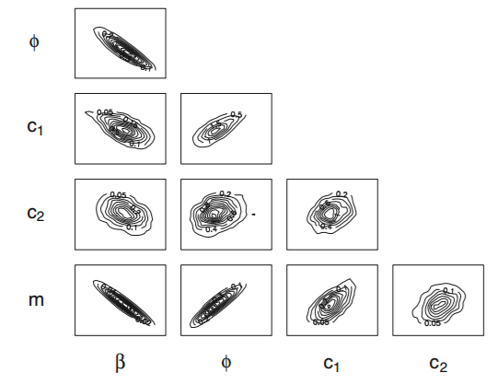
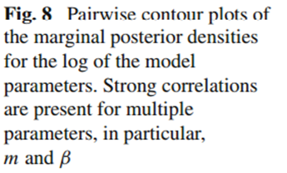
Line search MCMC
When Markov chain Monte Carlo (MCMC) algorithms are used with complex mechanistic models, convergence times are often severely compromised by poor mixing rates and a lack of computational power
Kennedy et al, 2015

Slide 25
Line search MCMC
Use likelihood calculation in line search algorithm, running many line searches in parallel
Use line search results in principal components analysis (PCA), to de-correlate the parameters
Use PCA output to generate proposals for Metropolis-Hastings MCMC
likelihood
Loglikelihood
parameter 2
increasing value
Kennedy, David A., Vanja Dukic, and Greg Dwyer. "Combining principal component analysis with parameter line-searches to improve the efficacy of Metropolis–Hastings MCMC." Environmental and Ecological Statistics 22.2 (2015): 247-274.
increasing value
parameter 1
Notes:
Line search: choose initial parameter values; hold all but one constant; calculate Lhood for ‘every’ possible parameter value within your bounds; update it when you find a better likelihood; then fix it and vary the next parameter, in turn
Terminates when you fail to update any parameter value for some set number of loops through the parameters
Time-consuming and computationally intensive, but you should only have to do it once, and then your MCMC will be fast and accurate

Slide 26
Line search MCMC
Use likelihood calculation in line search algorithm, running many line searches in parallel
Use line search results in principal components analysis (PCA), to de-correlate the parameters
Use PCA output to generate proposals for Metropolis-Hastings MCMC
likelihood
Loglikelihood
parameter 2
increasing value
Kennedy, David A., Vanja Dukic, and Greg Dwyer. "Combining principal component analysis with parameter line-searches to improve the efficacy of Metropolis–Hastings MCMC." Environmental and Ecological Statistics 22.2 (2015): 247-274.
increasing value
parameter 1
Notes:
Line search: choose initial parameter values; hold all but one constant; calculate Lhood for ‘every’ possible parameter value within your bounds; update it when you find a better likelihood; then fix it and vary the next parameter, in turn
Terminates when you fail to update any parameter value for some set number of loops through the parameters
Time-consuming and computationally intensive, but you should only have to do it once, and then your MCMC will be fast and accurate

Slide 27
Line search MCMC
Use likelihood calculation in line search algorithm, running many line searches in parallel
Use line search results in principal components analysis (PCA), to de-correlate the parameters
Use PCA output to generate proposals for Metropolis-Hastings MCMC
likelihood
Loglikelihood
parameter 2
increasing value
Kennedy, David A., Vanja Dukic, and Greg Dwyer. "Combining principal component analysis with parameter line-searches to improve the efficacy of Metropolis–Hastings MCMC." Environmental and Ecological Statistics 22.2 (2015): 247-274.
increasing value
parameter 1
Notes:
Line search: choose initial parameter values; hold all but one constant; calculate Lhood for ‘every’ possible parameter value within your bounds; update it when you find a better likelihood; then fix it and vary the next parameter, in turn
Terminates when you fail to update any parameter value for some set number of loops through the parameters
Time-consuming and computationally intensive, but you should only have to do it once, and then your MCMC will be fast and accurate

Slide 28
Line search MCMC
Use likelihood calculation in line search algorithm, running many line searches in parallel
Use line search results in principal components analysis (PCA), to de-correlate the parameters
Use PCA output to generate proposals for Metropolis-Hastings MCMC
likelihood
Loglikelihood
parameter 2
increasing value
Kennedy, David A., Vanja Dukic, and Greg Dwyer. "Combining principal component analysis with parameter line-searches to improve the efficacy of Metropolis–Hastings MCMC." Environmental and Ecological Statistics 22.2 (2015): 247-274.
increasing value
parameter 1
Notes:
Line search: choose initial parameter values; hold all but one constant; calculate Lhood for ‘every’ possible parameter value within your bounds; update it when you find a better likelihood; then fix it and vary the next parameter, in turn
Terminates when you fail to update any parameter value for some set number of loops through the parameters
Time-consuming and computationally intensive, but you should only have to do it once, and then your MCMC will be fast and accurate

Slide 29
Line search MCMC
Use likelihood calculation in line search algorithm, running many line searches in parallel
Use line search results in principal components analysis (PCA), to de-correlate the parameters
Use PCA output to generate proposals for Metropolis-Hastings MCMC
likelihood
Loglikelihood
parameter 2
increasing value
Kennedy, David A., Vanja Dukic, and Greg Dwyer. "Combining principal component analysis with parameter line-searches to improve the efficacy of Metropolis–Hastings MCMC." Environmental and Ecological Statistics 22.2 (2015): 247-274.
increasing value
parameter 1
Notes:
Line search: choose initial parameter values; hold all but one constant; calculate Lhood for ‘every’ possible parameter value within your bounds; update it when you find a better likelihood; then fix it and vary the next parameter, in turn
Terminates when you fail to update any parameter value for some set number of loops through the parameters
Time-consuming and computationally intensive, but you should only have to do it once, and then your MCMC will be fast and accurate

Slide 30
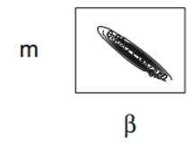
Line search MCMC
Use likelihood calculation in line search algorithm, running many line searches in parallel
2) Use line search results in principal components analysis (PCA), to de-correlate the parameters
Use PCA output to generate proposals for Metropolis-Hastings MCMC
Use likelihood calculation in line search algorithm, running many line searches in parallel
Use line search results in principal components analysis (PCA), to de-correlate the parameters
Use PCA output to generate proposals for MCMC
Kennedy, David A., Vanja Dukic, and Greg Dwyer. "Combining principal component analysis with parameter line-searches to improve the efficacy of Metropolis–Hastings MCMC." Environmental and Ecological Statistics 22.2 (2015): 247-274.
Notes:
Line search: choose initial parameter values; hold all but one constant; calculate Lhood for ‘every’ possible parameter value within your bounds; update it when you find a better likelihood; then fix it and vary the next parameter, in turn
Terminates when you fail to update any parameter value for some set number of loops through the parameters
Time-consuming and computationally intensive, but you should only have to do it once, and then your MCMC will be fast and accurate

Slide 31
Line search MCMC
Use likelihood calculation in line search algorithm, running many line searches in parallel
Use line search results in principal components analysis (PCA), to de-correlate the parameters
Use PCA output to generate proposals for MCMC
Kennedy, David A., Vanja Dukic, and Greg Dwyer. "Combining principal component analysis with parameter line-searches to improve the efficacy of Metropolis–Hastings MCMC." Environmental and Ecological Statistics 22.2 (2015): 247-274.
Notes:
Line search: choose initial parameter values; hold all but one constant; calculate Lhood for ‘every’ possible parameter value within your bounds; update it when you find a better likelihood; then fix it and vary the next parameter, in turn
Terminates when you fail to update any parameter value for some set number of loops through the parameters
Time-consuming and computationally intensive, but you should only have to do it once, and then your MCMC will be fast and accurate

Slide 32
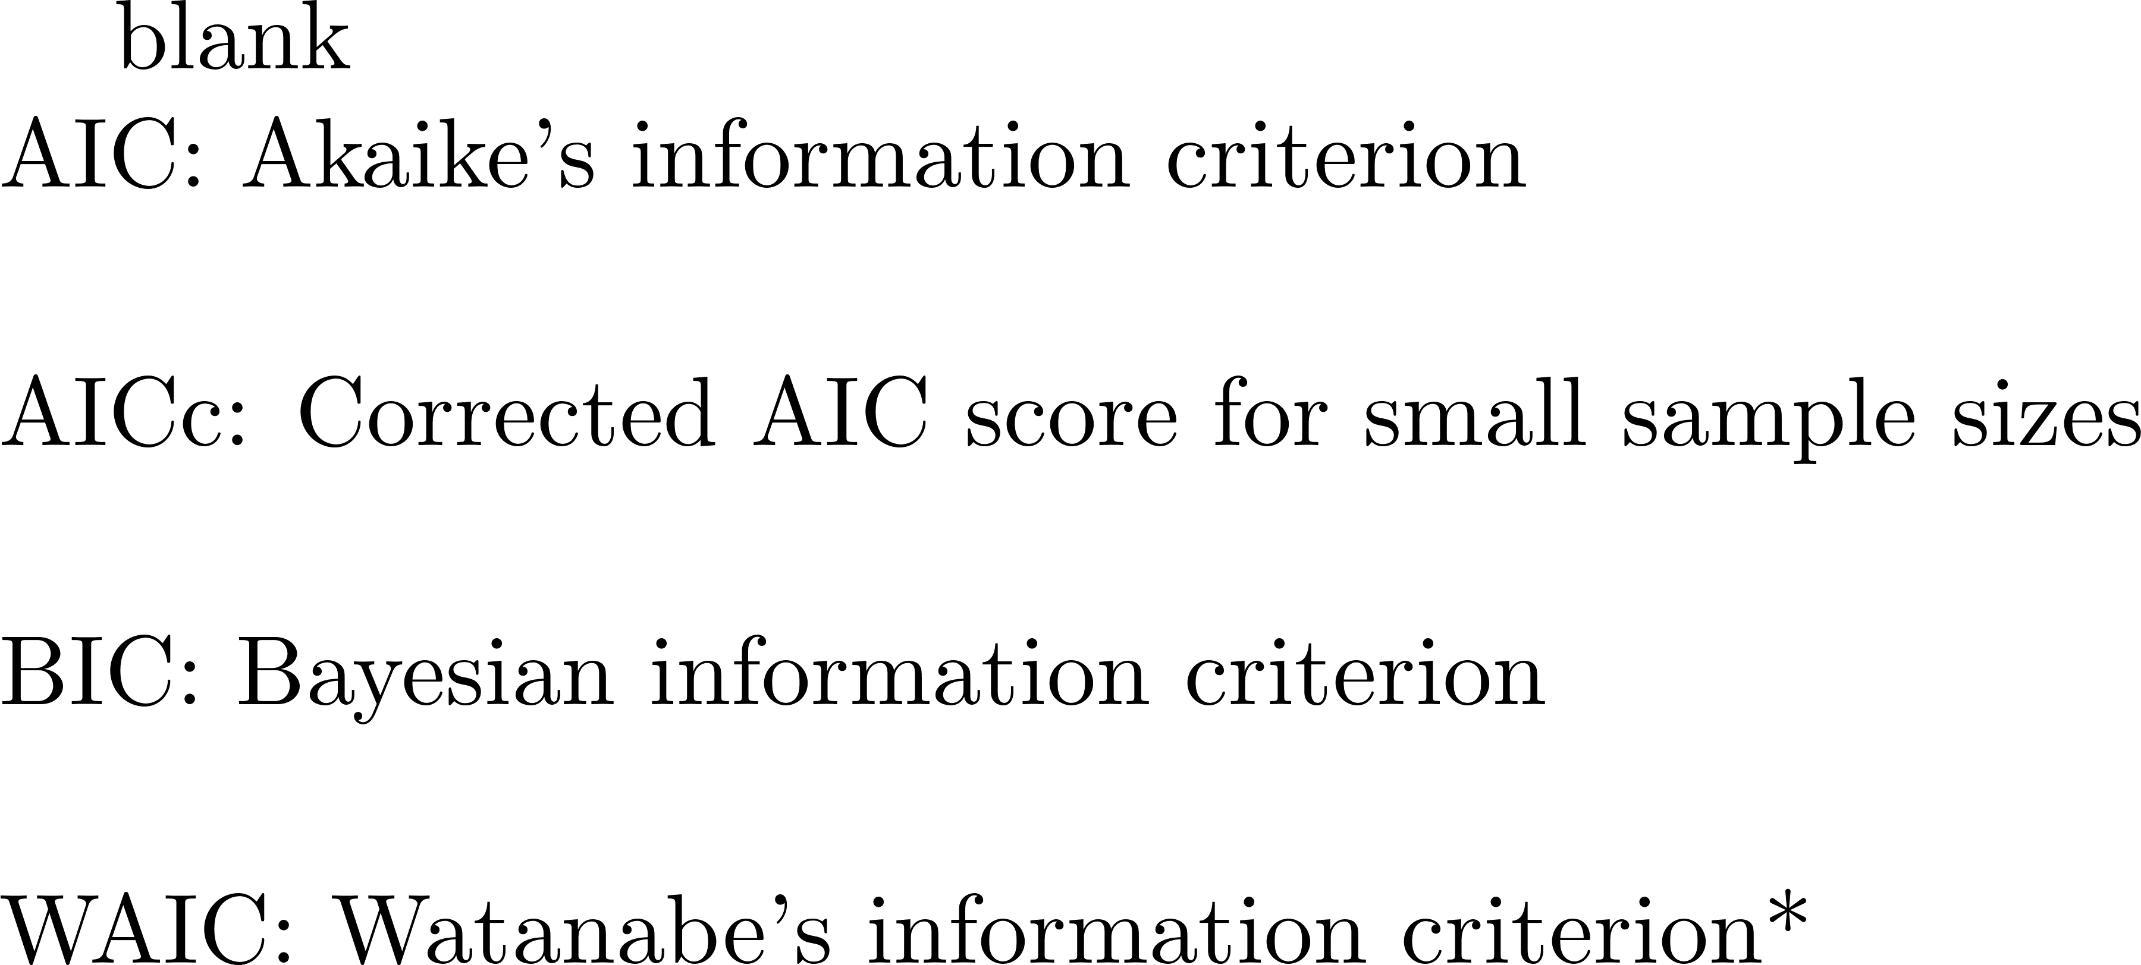
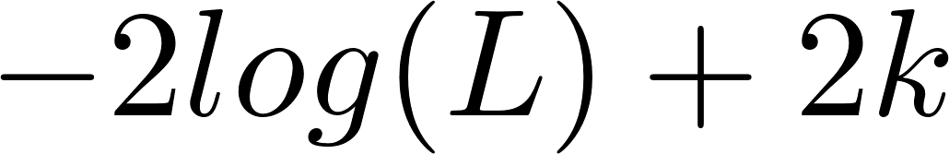
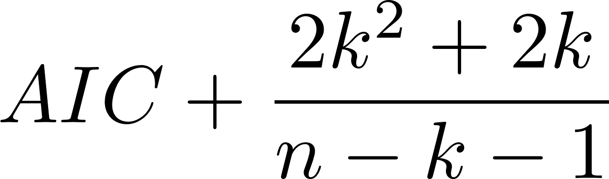
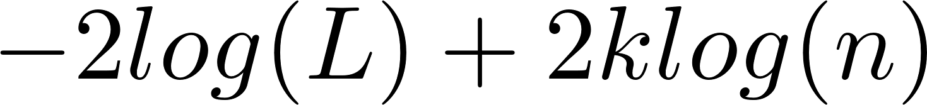
Model selection
Kullback, Solomon, and Richard A. Leibler. "On information and sufficiency." The annals of mathematical statistics 22.1 (1951): 79-86.
Notes:
All of these are based on information theory. How much does your model differ from reality; how much information has been lost?

Slide 33
Model selection
Kullback, Solomon, and Richard A. Leibler. "On information and sufficiency." The annals of mathematical statistics 22.1 (1951): 79-86.
Notes:
All of these are based on information theory: How much does your model differ from reality – how much information has been lost?
where L is the maximized value of the likelihood function for that model, and k is the number of parameters in the model
Important to note: for *all* of these, the score is contingent upon both the model and the associated MLE parameter values
The -2 is there for “historical reasons”

Slide 34
Model selection
Kullback, Solomon, and Richard A. Leibler. "On information and sufficiency." The annals of mathematical statistics 22.1 (1951): 79-86.
Notes:
Important to note: for *all* of these, the score is contingent upon both the model and the associated MLE parameter values
AICc: for small sample sizes – defined to be n/k < 40
Assuming that the model is univariate, is linear in its parameters, and has normally-distributed residuals (conditional upon regressors), then the formula for AICc is as follows

Slide 35

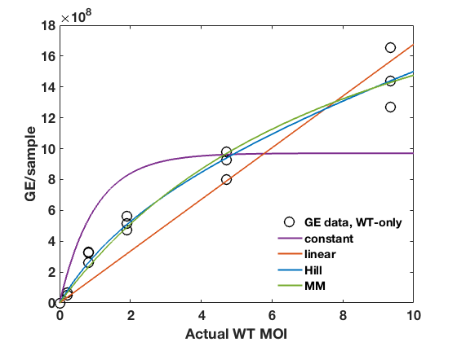

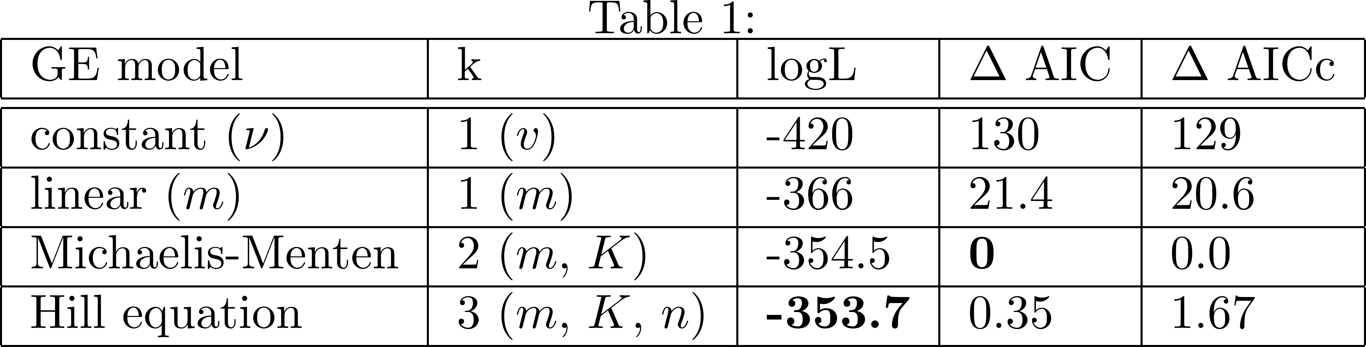
Model selection example
Viral output (total)
Jeremy Harris @ Emory
Brigitte Martin @ UIUC
Viral input (viruses per cell)

Slide 36
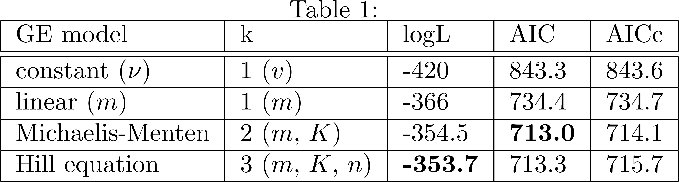
Model selection example
Viral output (total)
Viral input (viruses per cell)
WT MOI

Slide 37
Model selection example
Viral output (total)
Viral input (viruses per cell)
WT MOI
Notes:
Need a difference of at least 2 between AIC scores to report that one model is better than the other; 2-4 is marginal, up to 10

Slide 38
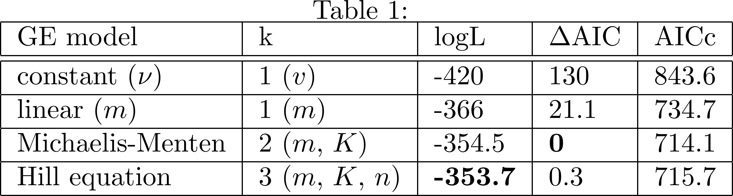
Model selection example
Viral output (total)
Viral input (viruses per cell)
WT MOI
Notes:
Need a difference of at least 2 between AIC scores to report that one model is better than the other; 2-4 is marginal, up to 10

Slide 39
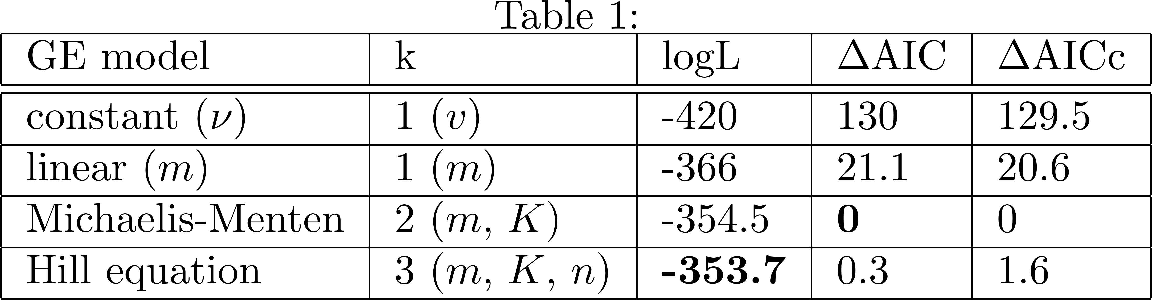
Model selection example
Viral output (total)
Viral input (viruses per cell)
WT MOI
Notes:
Need a difference of at least 2 between AIC scores to report that one model is better than the other; 2-4 is marginal, up to 10

Slide 40
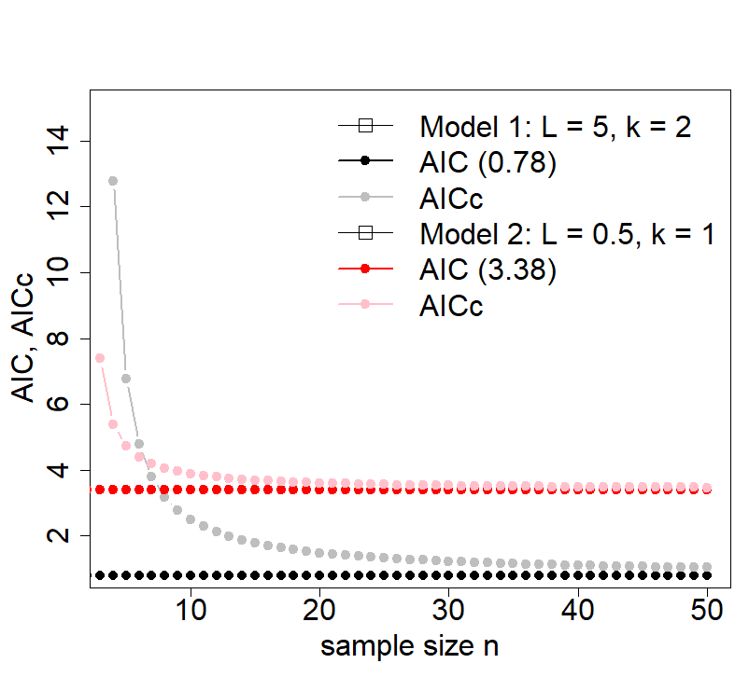
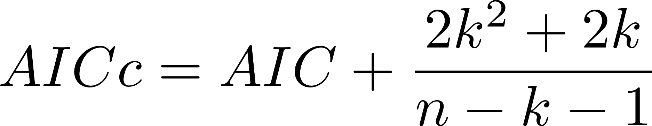
Notes:
Note that for model selection to be meaningful, you’d best have more data points than parameters

Slide 41
Model selection
Kullback, Solomon, and Richard A. Leibler. "On information and sufficiency." The annals of mathematical statistics 22.1 (1951): 79-86.
Notes:
Important to note: for *all* of these, the score is contingent upon both the model and the associated MLE parameter values
The name ‘Bayesian’ information criterion is misleading – both AIC and BIC can be used in either a frequentist or Bayesian approach
AIC can be justified as ‘Bayesian’ if using an informative prior
BIC can be derived as a non-Bayesian result – and further, requires that the *true* model be present in the suite of models you are choosing between
BIC is not an estimation of predictive fit, but approximates the marginal probability density of the data under the model

Slide 42
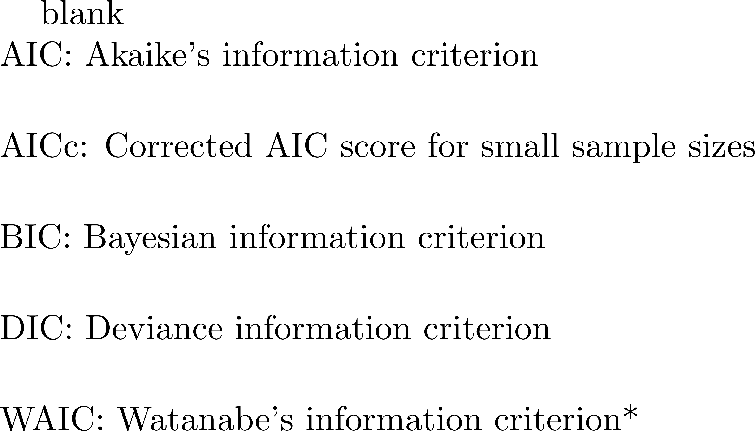
Model selection
Kullback, Solomon, and Richard A. Leibler. "On information and sufficiency." The annals of mathematical statistics 22.1 (1951): 79-86.

Slide 43
Model selection
Kullback, Solomon, and Richard A. Leibler. "On information and sufficiency." The annals of mathematical statistics 22.1 (1951): 79-86.

Slide 44
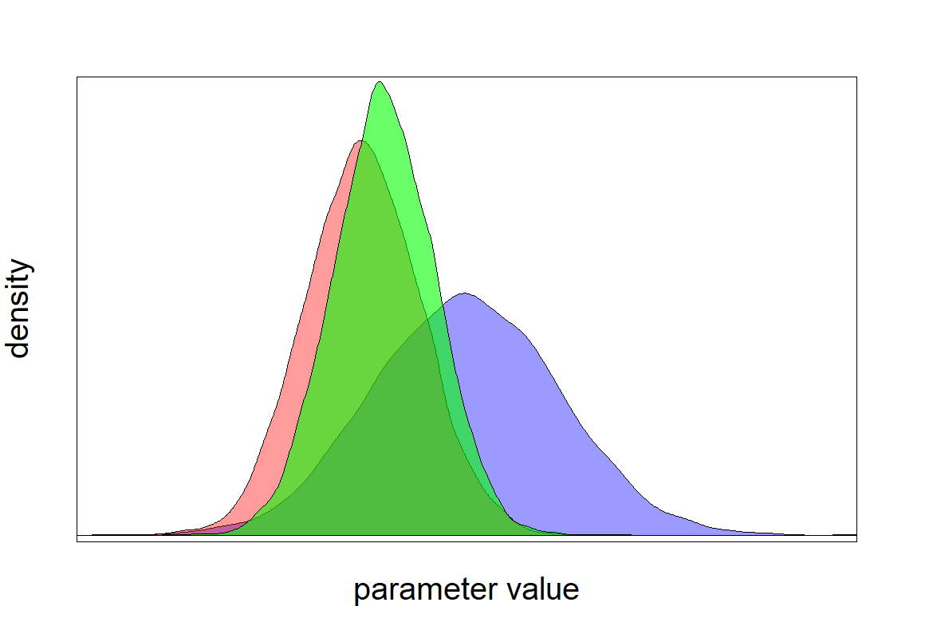
WAIC calculation
Sample a matrix of parameter values from the posterior of the distribution
The penalty term then is the average variance in the likelihood calculations
across your posterior sample of parameters
posterior
likelihood
prior

Slide 45
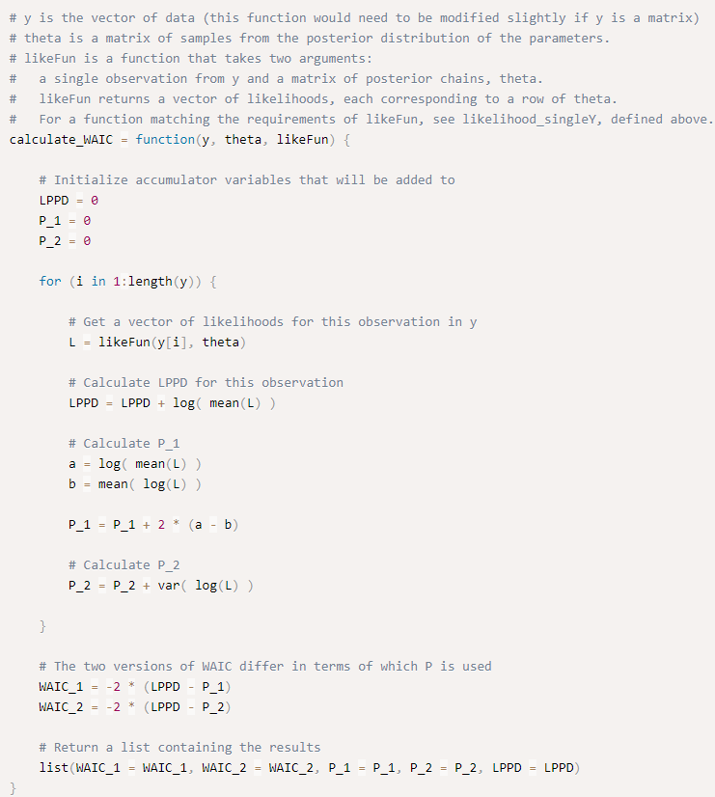
The code for this calculation is easy to write, and there is also an R package available:
R package: LaplacesDemon
By Henrik Singmann
Code by
Kyle Hardmann
Notes:
This R package might also do gelman-rubin diagnostics

Slide 46
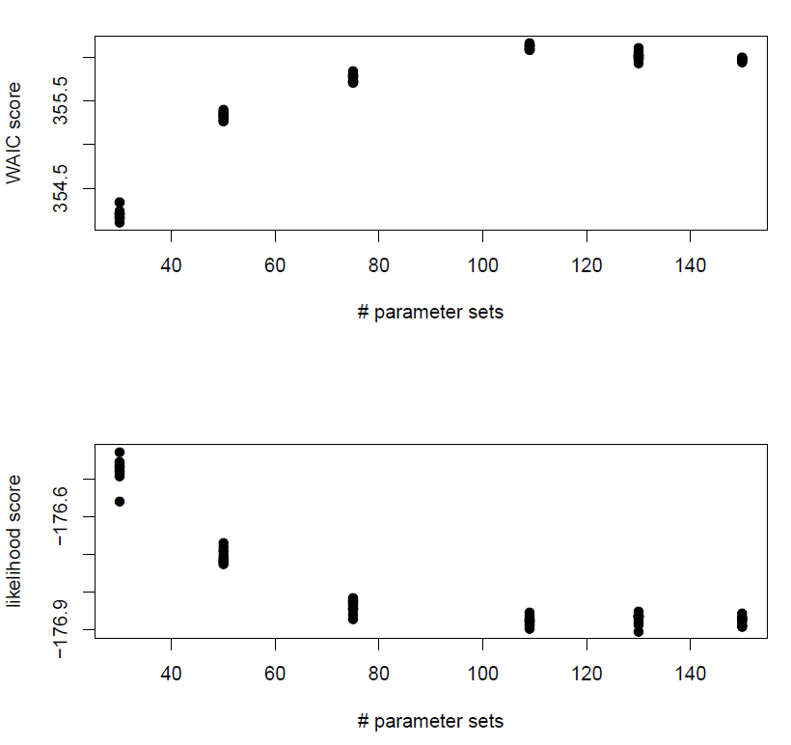
How many parameter sets from the posterior should be used to calculate WAIC?

Slide 47
Model selection resources
Burnham, Kenneth P., and David R. Anderson (2002). "Model selection and multimodel inference."
Gelman, A., Carlin, J.B., Stern, H.S., Dunson, D.B., Vehtari, A., and Rubin, D.B. (2014). "Bayesian Data Analysis, 3rd ed.“
Watanabe, S. (2010). "Asymptotic Equivalence of Bayes Cross Validation and Widely Applicable Information Criterion in Singular Learning Theory". Journal of Machine Learning Research, 11, p. 3571--3594.
R package: LaplacesDemon
https://statmodeling.stat.columbia.edu/
mgallagher@emory.edu
Twitter, Github: mollyefg

